Slide 1

© 2002, Cisco Systems, Inc. All rights reserved.

Slide 2

Configuring Dial-on-Demand Routing
© 2002, Cisco Systems, Inc. All rights reserved.
Notes:
Purpose: This chapter introduces the Cisco IOS™ CLI on the Catalyst® 1900 switch and router.
Timing: This chapter should take about 2 hours to present.
Note: The Catalyst 1900 switch only has a subset of the router Cisco IOS commands available.
Contents:
Introduction to Cisco IOS. Explain to the student what is IOS?
Cisco Device startup procedures in general.
IOS configuration source.
General introduction to the IOS CLI.
Cat 1900 switch startup procedures.
Intro to Cat 1900 CLI. This part covers the basic configuration on the switch, like setting the IP address and hostname. More details about the various Cat 1900 switch configuration commands are explained in Chapter 6 and 7.
Router startup procedures. More details on the router startup process is discussed in chapter 5.
Router IOS CLI.

Slide 3
Objectives
Upon completing this lesson, you will be
able to:
  Configure legacy DDR, given a functioning remote access router and a physical ISDN connection
  Use show commands to identify the anomalies in the legacy DDR configurations, given a functioning remote access router and a physical ISDN connection
  Use debug commands to identify the anomalies in the legacy DDR configurations, given a functioning remote access router and a physical ISDN connection
Notes:
Slide 1 of 2
Purpose: This slide states the chapter objectives.
Emphasize: Read or state each objective so that each student has a clear understanding of the chapter objectives.
Note: Catalyst switches have different CLIs. The Catalyst 2900xl and the Catalyst 1900 has a Cisco IOS CLI. The Cisco IOS CLI commands available on the 2900xl is different from the 1900. The Catalyst 5000 family has no Cisco IOS CLI, and use the set commands instead. This class only covers the configuration on the Catalyst 1900 switch.

Slide 4
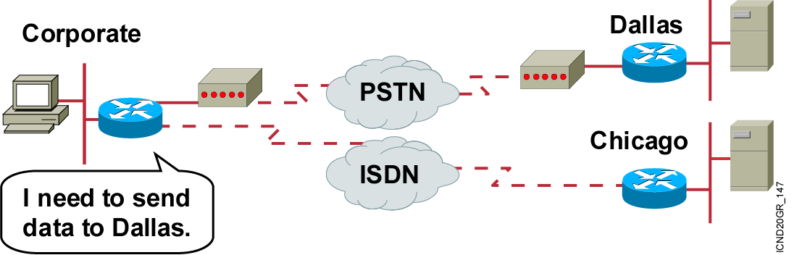
What Is Dial-on-Demand Routing?
Connects when needed
Disconnects when finished
ISDN or PSTN
Notes:
Purpose: This figure introduces students to DDR.
Emphasize: Explain that DDR is used to refer to a collection of dial-up features.

Slide 5
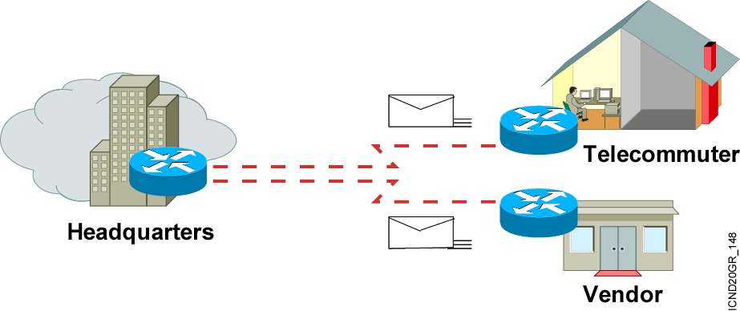
When to Use DDR
Periodic connections
Small amounts of data
Notes:
Purpose: This figure explains when you would want to use DDR.
Emphasize: DDR is used for low-volume, periodic connections when traffic demands do not dictate the use of a dedicated line. DDR addresses the need for periodic network connections over a circuit-switched WAN service. By using WAN connections only on an as-need basis, DDR saves WAN usage costs.
Note: Provide some scenarios when DDR may be used.

Slide 6
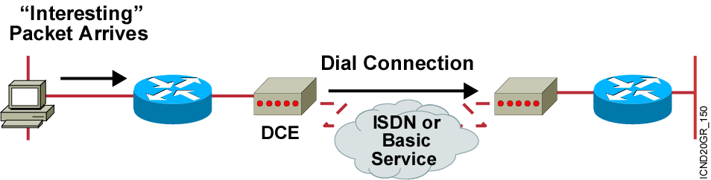
Generic DDR Operation
1. Route to destination is determined.
2. Interesting packets dictate DDR call.
3. Dialer information is looked up.
4. Traffic is transmitted.
5. Call is terminated.
Notes:
Layer 4 of 4
Purpose: This figure explains DDR operation.
Emphasize: Layer 4 adds fourth and fifth lines. After a user-defined idle period, the call is disconnected.
Point out that static routes are configured between the routers to avoid periodic transmissions over the WAN that would be caused by dynamic routing.

Slide 7

Configuring DDR
1
Define static routes—What route do I use?
Specify interesting traffic—What traffic enables the link?
Configure the dialer information—What number do I call?
1
2
3
Notes:
Layer 3 of 3
Purpose: This figure explains how to configure Legacy DDR.
Emphasize: Configure the dialer information.

Slide 8
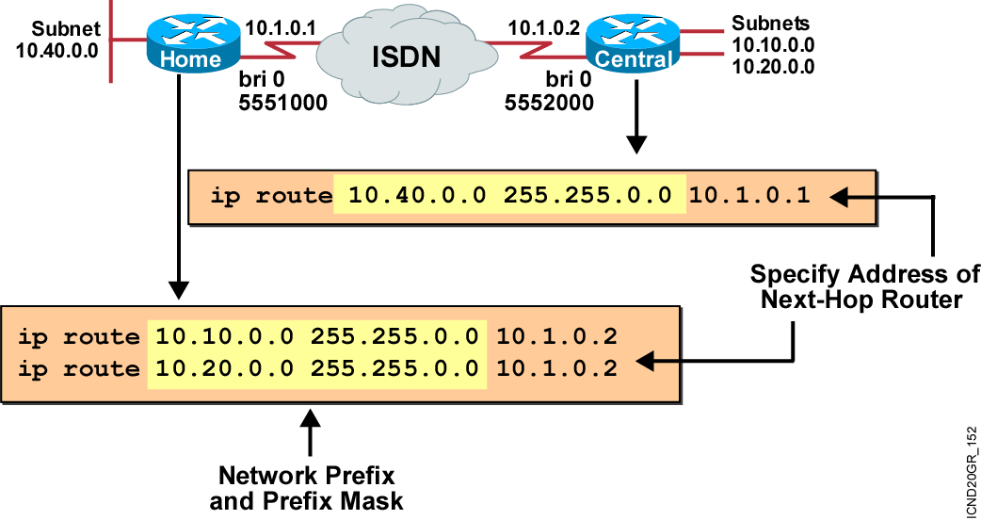
Defining Static Routes
Notes:
Purpose: This figure reviews how to configure a static route.
Emphasize: Static routes were covered in Chapter 9, “Determining IP Routes.” Static routes are commonly used with DDR. Dynamic routing protocols are not commonly used with DDR because the line could come up every time there is a routing update.

Slide 9
Specifying Interesting Traffic
dialer-list 1 protocol ip permit
Any IP traffic will initiate the link without access lists.
dialer-list 1 protocol ip list 101
access-list 101 deny tcp any any eq ftp
access-list 101 deny tcp any any eq telnet
access-list 101 permit ip any any
Denies FTP
Denies Telnet
Any IP traffic, except FTP and Telnet, will initiate the linking.
Using access lists gives finer control.
Notes:
Purpose: This figure explains how to specify interesting traffic on a Cisco router.
Emphasize: This step involves some planning because access lists allow for much flexibility.
You must know exactly what kind of traffic should engage the line.
The dialer-list protocol command identifies interesting traffic based on protocol type. It can be used to specify an entire protocol suite. It can also be used to link an access list that more narrowly defines interesting packets to a dialer group.

Slide 10
Configuring the Dialer Information
hostname Home
!
isdn switch-type basic-5ess
!
username central password cisco
interface BRI0
ip address 10.1.0.1 255.255.255.0
encapsulation ppp
dialer idle-timeout 180
dialer map ip 10.1.0.2 name Central 5552000
dialer-group 1
no fair-queue
ppp authentication chap
!
router rip
network 10.0.0.0
!
no ip classless
ip route 10.10.0.0 255.255.0.0 10.1.0.2
ip route 10.20.0.0 255.255.0.0 10.1.0.2
!
dialer-list 1 protocol ip permit
Applies rules defined by dialer-list to individual interfaces
Both Values
Must Match
Notes:
Purpose: This figure explains how to configure the dialer interface.
Emphasize: Remind students to configure PPP on the dialer interface as they did on the serial interface in Chapter 12, “Establishing Serial Point-to-Point Connections.” PPP is the data-link protocol operating on the B channels.
The dialer-group command assigns an interface to a dialer access group (specified with the dialer-list command), and connects the interface to access list statements that identify interesting protocol traffic.
You can apply the same dialer list to one or more interfaces.

Slide 11
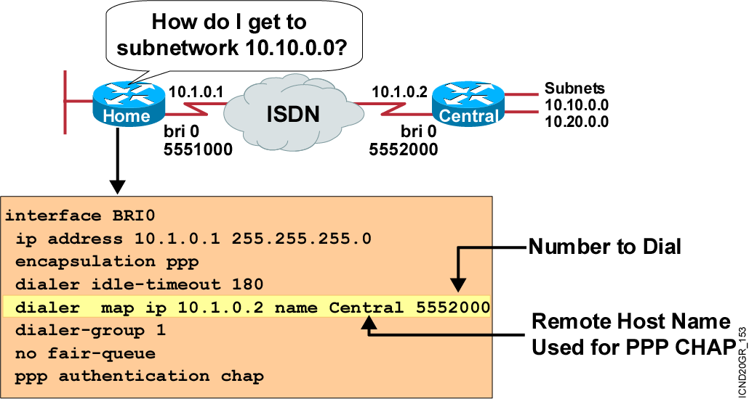
Configuring the Dialer Information (Cont.)
Notes:
Purpose: This figure further explains how to configure the dialer interface.
Emphasize: The dialer-map command maps the remote protocol address to a telephone number. You need this command if you will be dialing multiple sites. If you will be dialing only one site, you could use an unconditional dialer string command that always dials the one phone number regardless of the traffic destination.
Note: This step is unique to Legacy DDR. Although the information is always required, the steps to configure destination information are different if using dialer profiles instead of Legacy DDR.
If you are dialing only one site, you could use the dialer-string command, although this method is rarely used because it does not allow for authentication.

Slide 12
Optional Legacy DDR Commands
Router(config-if)#dialer load-threshold load
[outbound | inbound | either]
  Establishes the amount of traffic on the link before a second link is enabled
Router(config-if)#dialer idle-timeout seconds
  Establishes the idle time before disconnect
Notes:
Purpose: This figure presents some optional DDR commands.
Emphasize: The dialer idle-timeout has a default value of 120.
The dialer idle-timeout command specifies the amount of time the link stays idle before the connection is terminated. The dialer idle-timeout command is like a stopwatch. When the last interesting packet leaves the router, the router sets a timer to measure how long the interface is idle (defined by the absence of interesting traffic). If interesting traffic arrives, the timer is reset. If no interesting packets arrive at the interface before the timer expires, then the call is hung up even if noninteresting traffic is on the line.
The dialer load-threshold controls the conditions under which another call can be placed to the same destination. If you had too much traffic trying to squeeze over one phone line, then based on this parameter you may wish to place another simultaneous call to increase your bandwidth.
In releases before 11.1, load was only monitored in the outgoing direction.

Slide 13
Legacy DDR Configuration Tasks Summarized
hostname Home
!
isdn switch-type basic-5ess
!
username central password cisco
interface BRI0
ip address 10.1.0.1 255.255.255.0
encapsulation ppp
dialer idle-timeout 180
dialer map ip 10.1.0.2 name Central 5552000
dialer-group 1
no fair-queue
ppp authentication chap
!
router rip
network 10.0.0.0
!
no ip classless
ip route 10.10.0.0 255.255.0.0 10.1.0.2
ip route 10.20.0.0 255.255.0.0 10.1.0.2
dialer-list 1 protocol ip permit
!
3
1
2
Notes:
Purpose: This figure summarizes the tasks just presented.
Emphasize: Many times a configuration can look very confusing and complex. This page attempts to simplify the DDR configuration by showing a comprehensive configuration and matching the commands to the tasks just discussed.
Match the commands to the configuration tasks.

Slide 14
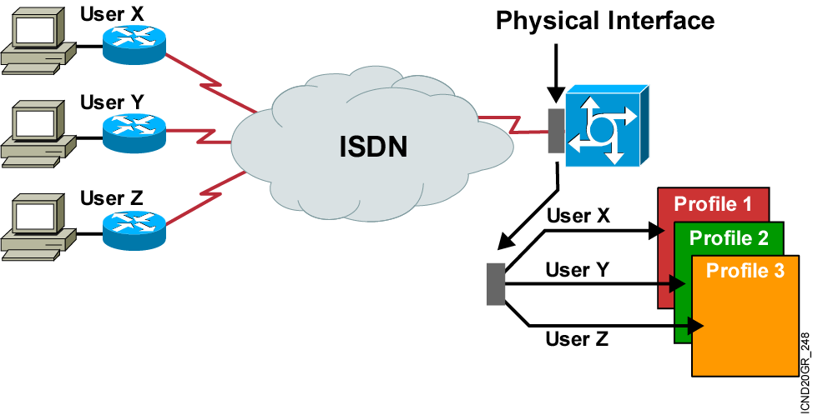
Dialer Profiles Overview
Notes:
Purpose: This figure presents a more detailed view and explanation of dialer profile functions.
Emphasize: Discuss the points covered in the Student Guide text that relate to the functionality of dialer profiles.
Transition: The next figure shows the hardware and software elements of a dialer profile.

Slide 15
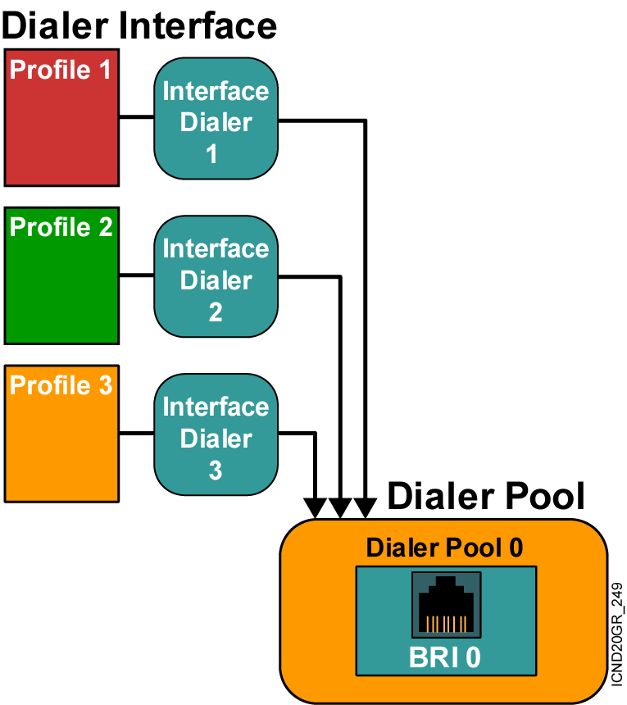
Dialer Profile Elements
Notes:
Purpose: This figure shows the hardware and software elements of a dialer profile.
Emphasize: Introduce each element. Each element will be discussed in more detail later.
Transition: The next figure shows the map class element of a dialer profile.

Slide 16
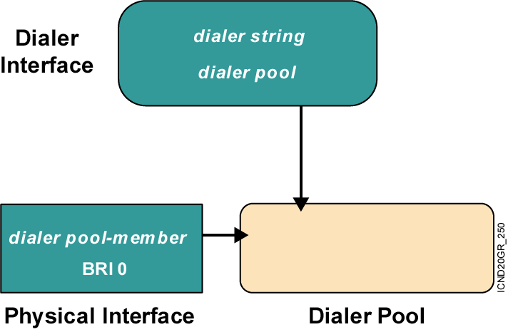
Dialer Profile Configuration Concepts and Commands
Notes:
Purpose: This figure shows how the commands for dialer profile elements are related and linked to each other.
Emphasize: The map class is created and can be used by configuring the dialer string command with the class argument.
Transition: The next figure shows an application for dialer profiles.

Slide 17
Configuring Dialer Interfaces
interface dialer1
ip address 10.1.1.1 255.255.255.0
encapsulation ppp
dialer remote-name Smalluser
dialer string 5554540
dialer idle-timer 180
dialer pool 1
dialer-group 1
ppp authentication chap
!
interface dialer2
ip address 10.2.2.1 255.255.255.0
encapsulation ppp
dialer remote-name Mediumuser
dialer string 5551234
dialer idle-timer 180
dialer pool 1
dialer-group 2
interface dialer3
ip address 10.3.3.1 255.255.255.0
encapsulation ppp
dialer remote-name Poweruser
dialer string 4155554321
dialer idle-timer 300
dialer pool 1
dialer-group 3
(cont.)
Notes:
Purpose: This figure shows an example dialer interface configuration.
Emphasize: Discuss each line of the configuration and relate each one to the concepts presented on previous pages. Also discuss the tasks necessary to create this configuration.
Transition: The next figure shows how to configure physical interfaces to be part of a dialer profile.

Slide 18
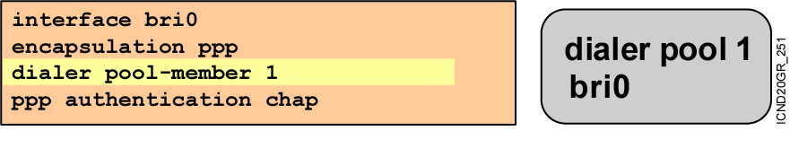
Configuring Physical Interfaces
Notes:
Purpose: This figure shows how to configure physical interfaces to be part of a dialer profile.
Emphasize: A physical interface can be a member of more than one dialer pool. Priority is used for outgoing calls only.
Transition: The next figure shows a dialer profile configuration example.

Slide 19
Verifying DDR and ISDN Operation
Router#ping or telnet
Triggers a link
Router#show dialer
Displays current status of the link
Router#show isdn active
Displays call status while call is in progress
Router#show isdn status
Displays the status of an ISDN connection
Router#show ip route
Displays all routes, including static routes
Notes:
Slide 1 of 2
Purpose: This figure highlights some of the verification commands used in ISDN.
Emphasize: Summarize the commands shown and provide examples of when each is used.

Slide 20
Verifying Dialer Profiles Operation
NASX#show dialer interface bri0
Dial String Successes Failures Last called Last status
5553872 6 0 19 secs Successful
0 incoming call(s) have been screened.
BRI0: B-Channel 1
Idle timer (120 secs), Fast idle timer (20 secs)
Wait for carrier (30 secs), Re-enable (15 secs)
Time until disconnect 102 secs
Current call connected 00:00:19
Connected to 5553872 (system1)
BRI0: B-Channel 2
Idle timer (120 secs), Fast idle timer (20 secs)
Wait for carrier (30 secs), Re-enable (15 secs)
Dialer state is idle
BRI0 - dialer type = ISDN
Dialer state is data link layer up
Dial reason: ip (s=10.1.1.8, d=10.1.1.1)
Interface bound to profile Dialer0
Notes:
Purpose: This figure shows the show dialer command used to verify a dialer profile operation.
Emphasize: Discuss the output of the command and emphasize the highlighted lines.
Transition: The next section contains the laboratory exercise.

Slide 21
Troubleshooting DDR and ISDN Operation
Router#debug isdn q921
Shows ISDN Layer 2 messages
Router#debug isdn q931
Shows ISDN call setup and teardown activity
Router#debug dialer [events | packets]
Displays DDR debugging information about the packets received on a dialer interface
Router(config-if)#shutdown
Clears currently established connections from the interface
Notes:
Slide 2 of 2
Purpose: This figure further highlights some of the verification commands used in ISDN.
Emphasize: Summarize the commands shown and provide examples of when each is used.

Slide 22
debug isdn q921 Example
Router#debug isdn q921
Jan 3 14:52:24.475: ISDN BR0: TX -> INFOc sapi = 0 tei = 64 ns = 5 nr = 2
i = 0x08010705040288901801837006803631383835
Jan 3 14:52:24.503: ISDN BR0: RX <- RRr sapi = 0 tei = 64 nr = 6
Jan 3 14:52:24.527: ISDN BR0: RX <- INFOc sapi = 0 tei = 64 ns = 2 nr = 6
i = 0x08018702180189
Jan 3 14:52:24.535: ISDN BR0: TX -> RRr sapi = 0 tei = 64 nr = 3
Jan 3 14:52:24.643: ISDN BR0: RX <- INFOc sapi = 0 tei = 64 ns = 3 nr = 6
i = 0x08018707
Jan 3 14:52:24.655: ISDN BR0: TX -> RRr sapi = 0 tei = 64 nr = 4
%LINK-3-UPDOWN: Interface BRI0:1, changed state to up
Jan 3 14:52:24.683: ISDN BR0: TX -> INFOc sapi = 0 tei = 64 ns = 6 nr = 4
i = 0x0801070F
Jan 3 14:52:24.699: ISDN BR0: RX <- RRr sapi = 0 tei = 64 nr = 7
%LINEPROTO-5-UPDOWN: Line protocol on Interface BRI0:1, changed state to up
%ISDN-6-CONNECT: Interface BRI0:1 is now connected to 61885 goodie
Jan 3 14:52:34.415: ISDN BR0: RX <- RRp sapi = 0 tei = 64 nr = 7
Jan 3 14:52:34.419: ISDN BR0: TX -> RRf sapi = 0 tei = 64 nr = 4

Slide 23
debug isdn q931 Examples
Router#debug isdn q931
TX -> SETUP pd = 8 callref = 0x04
Bearer Capability i = 0x8890
Channel ID i = 0x83
Called Party Number i = 0x80, `415555121202'
RX <- CALL_PROC pd = 8 callref = 0x84
Channel ID i = 0x89
RX <- CONNECT pd = 8 callref = 0x84
TX -> CONNECT_ACK pd = 8 callref = 0x04....
Call Setup
Procedure for
Outgoing Call
Router#debug isdn q931
RX <- SETUP pd = 8 callref = 0x06
Bearer Capability i = 0x8890
Channel ID i = 0x89
Calling Party Number i = 0x0083, `81012345678902'
TX -> CONNECT pd = 8 callref = 0x86
RX <- CONNECT_ACK pd = 8 callref = 0x06
Call Setup
Procedure for
Incoming Call

Slide 24
debug dialer Examples
Router#debug dialer events
Dialing cause: Serial0: ip (s=172.16.1.111 d=172.16.2.22)
Router#debug dialer packets
BRI0: ip (s=10.1.1.8, d=10.1.1.1), 100 bytes, interesting (ip PERMIT)

Slide 25
Resolving Outbound Call Problems
Cause
Missing or incorrect “interesting traffic” definitions
Incorrect interface state
Misconfigured dialer map
Misconfigured dialer profile
Suggested Actions
Verify the configuration using show running-configuration
Ensure that the interface state is “up/up” (spoofing)
Make sure the dialing interface has at least one dialer map statement
Make sure the dialer interface is configured with a dialer pool X command

Slide 26
Summary
  Dial-on-demand routing refers to a collection of Cisco features that allows two or more Cisco routers to establish a dynamic connection over simple dialup facilities.
  DDR operates by first determining the route to the destination, then, if the traffic is “interesting,” initiating a call.
  To configure DDR, first define the static routes, then specify interesting traffic, and finally configure the dialer information.
  Use static routes across a DDR link so that the number is not dialed just for routing updates.
Notes:
Purpose: This slide discuss the initial configurations on the routers and switches.
Note: There is no setup mode on the Catalyst 1900 switch.

Slide 27
Summary (Cont.)
  DDR calls are triggered by “interesting” traffic, which can be defined based on protocol, source address, destination address, or a variety of other criteria.
  Use the dialer-group and dialer map commands on an interface to associate a port and dialer-string with a
  dial list.
  To configure ISDN PRI with legacy DDR, you will configure dialer rotary groups and dialer profiles.
  You use show commands to display information about DDR configuration.
  You can use debug commands to help troubleshoot problems with a DDR configuration.
Notes:
Purpose: This slide discuss the initial configurations on the routers and switches.
Note: There is no setup mode on the Catalyst 1900 switch.

Slide 28
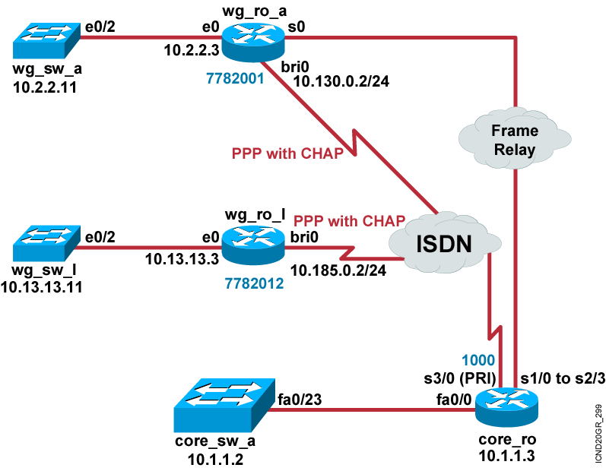
Visual Objective 9-1: Completing and ISDN BRI Call and DDR
Pod Router BRI
A 10.130.0.2
B 10.135.0.2
C 10.140.0.2
D 10.145.0.2
E 10.150.0.2
F 10.155.0.2
G 10.160.0.2
H 10.165.0.2
I 10.170.0.2
J 10.175.0.2
K 10.180.0.2
L 10.185.0.2
Notes:
Lab ISDN BRI/PRI config
Objectives: Establish an ISDN call.
Purpose: Teach students how to configure ISDN BRI and Legacy DDR on a Cisco router.
Laboratory Instructions: Refer to the lab setup guide.

Slide 29


